Slide 1
Algebraic Fractions
EQ – How do you multiply and divide algebraic fractions?
Mrs James
Year 10

Slide 2

Learning Intentions
Students will be able to
multiply and divide algebraic fractions
WICOR

Slide 3
24
7
30
Algebraic Fractions
Date:
EQ – How do you multiply and divide algebraic fractions?
Remember that when you multiply fractions, you multiply the numerators and multiply the denominators.
Remember that to divide by a fraction, you multiply by its reciprocal.

Slide 4
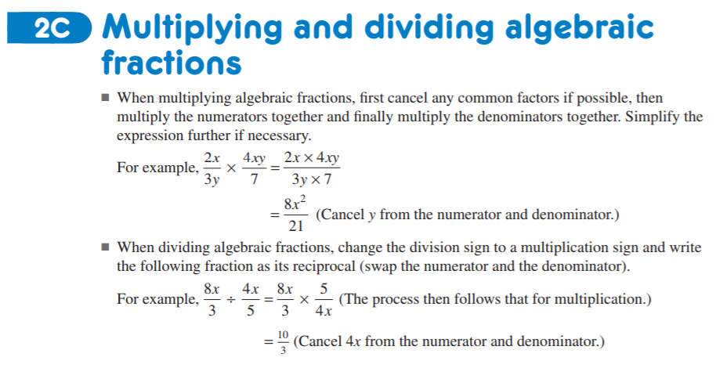
Practice
Nelson WA Maths 10
Example 18 cd, 21-23 p103-106
Teacher notes only

Slide 5
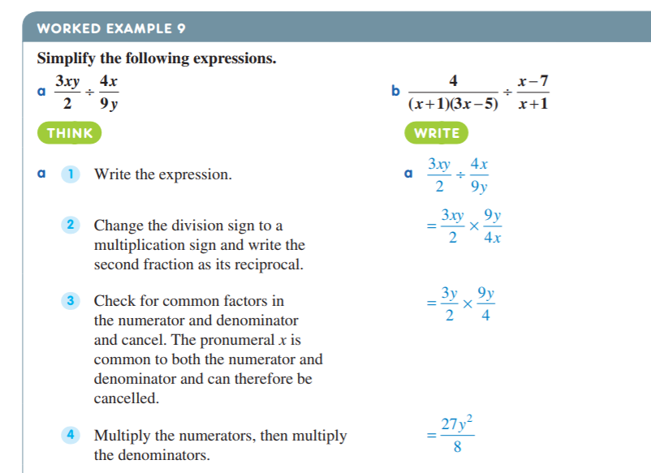
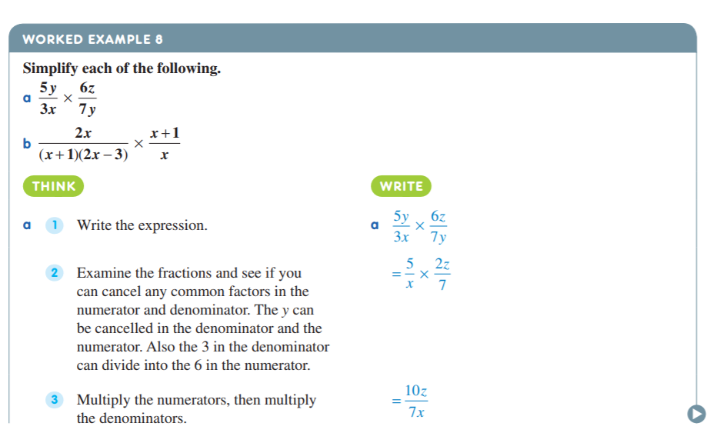
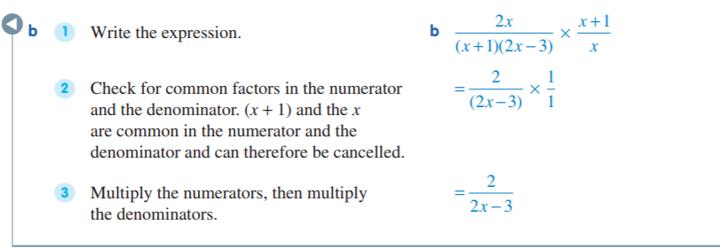
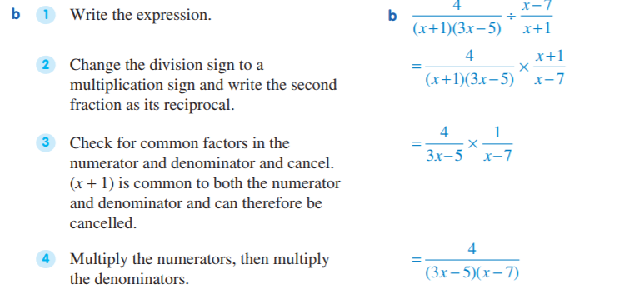
Teacher notes white board only

Slide 6
Task
algebraic fractions multiply/divide
Write a selection on the board as worksheet to big to print
differentiated practice worksheets with space for answers
Another lesson on this worksheet for independent practice
solutions included
Problem Solving
Nelson WA Maths 10 p108 Q7 and Q9
Remember “PEOPLE MATTER” and the 100% rule

